Slide 1
Capstone project 1: predicting customer turnout
Robert Vagi

Slide 2
EDA
Data were collected from AirRegi, a dining app that allows users to make reservations and pay with increased flexibility and convenience.
These included the date of each transaction, the number of visitors per transaction, if and when a reservation was made, the location of the restaurant, and the genre of the restaurant.
These data were supplemented with daily weather data gathered from the weather station closest to the restaurant.
Data were aggregated resampled by day to include the daily sum of visitors for each restaurant.

Slide 3
EDA
There were 296,279 unique day-restaurant observations in the dataset.
The data contained daily observations from Friday, January 1st, 2016 through Saturday, April 22nd, 2017.
The data contained information for 829 restaurants in 103 neighborhoods.

Slide 4
EDA
The ten neighborhoods with the most restaurants are listed below.
Neighborhood | Number of Restaurants
Fukuoka-ken Fukuoka-shi Daimyō | 64
Tōkyō-to Shibuya-ku Shibuya | 58
Tōkyō-to Minato-ku Shibakōen | 51
Tōkyō-to Shinjuku-ku Kabukichō | 39
Tōkyō-to Setagaya-ku Setagaya | 30
Tōkyō-to Chūō-ku Tsukiji | 29
Ōsaka-fu Ōsaka-shi Ōgimachi | 25
Hiroshima-ken Hiroshima-shi Kokutaijimachi | 23
Tōkyō-to Meguro-ku Kamimeguro | 22
Hokkaidō Sapporo-shi Minami 3 Jōnishi | 21

Slide 5

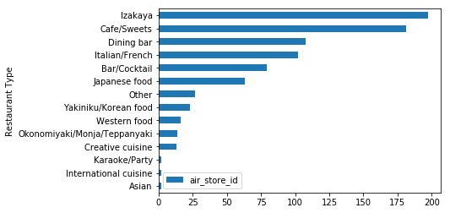
EDA
Restaurants represented 14 ‘genres.’
‘Izakaya’ and ‘Café/Sweets’ were the most common genres.

Slide 6
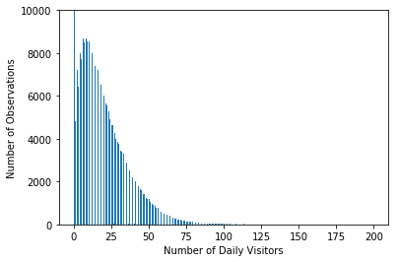
EDA
Descriptive Statistics:
n: 296,279
Mean: 17.8
Std: 16.6
Min: 0.0
25th percentile: 5.0
50th percentile: 14.0
75th percentile: 26.0
Max: 199.9
Note: There were a large number of observations with zero visitors (44,171).

Slide 7
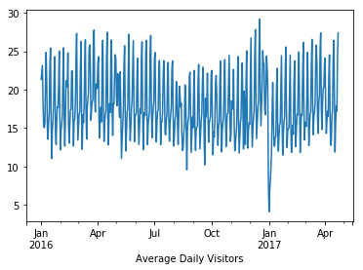
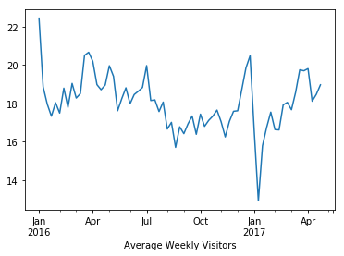
EDA
There are seasonal trends both within and across months. The number of visitors is highest in April through July, December, and January.
The months between August through November seem to slow down for restaurants.

Slide 8
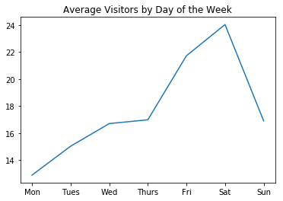
EDA
Monday is the slowest day of the week. The average number of visitors increases steadily throughout the week and drops sharply on Sunday.

Slide 9

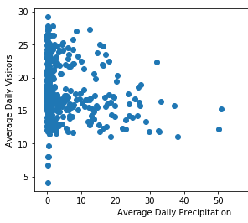
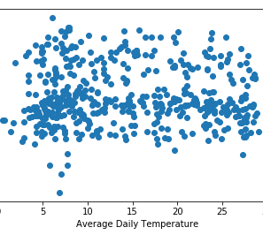
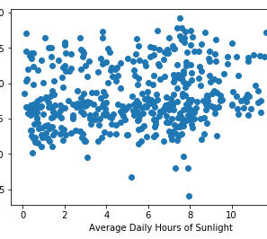
EDA
There does not appear to be a relationship between average daily visitors and average daily temperature or sunlight. However, there does appear to be a slight negative correlation between average daily visitors and average daily precipitation. However, a formal statistical test reveals a Pearson’s r of -.o4 (p < .001). Though this is statistically significant, it is of little practical significance.
Note: This test did not account for dependency in the data.

